Slide 1
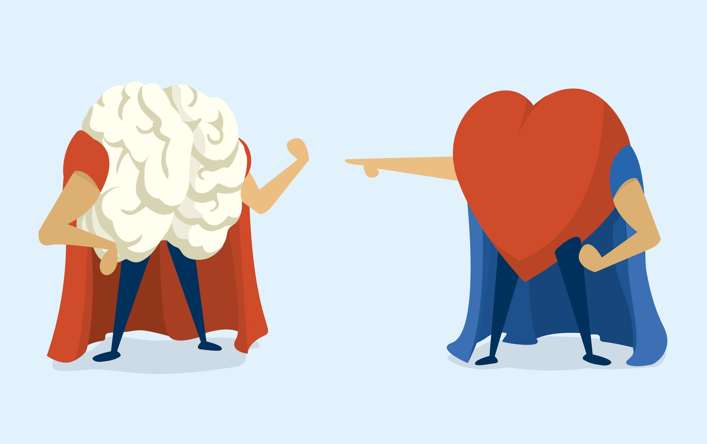
Introduction to Emotional Intelligence
Continuing Series of Working Together – Getting Along – Creating a Respectful Environment
By Bede Ramcharan, MHA

Slide 2
Lesson Overview
Purpose:
Understand EI and the relationship between ourselves and others
Understand the differences between EI and IQ
Understand the elements of EI
Good and Bad EI
EI and You – what can I do?

Slide 3
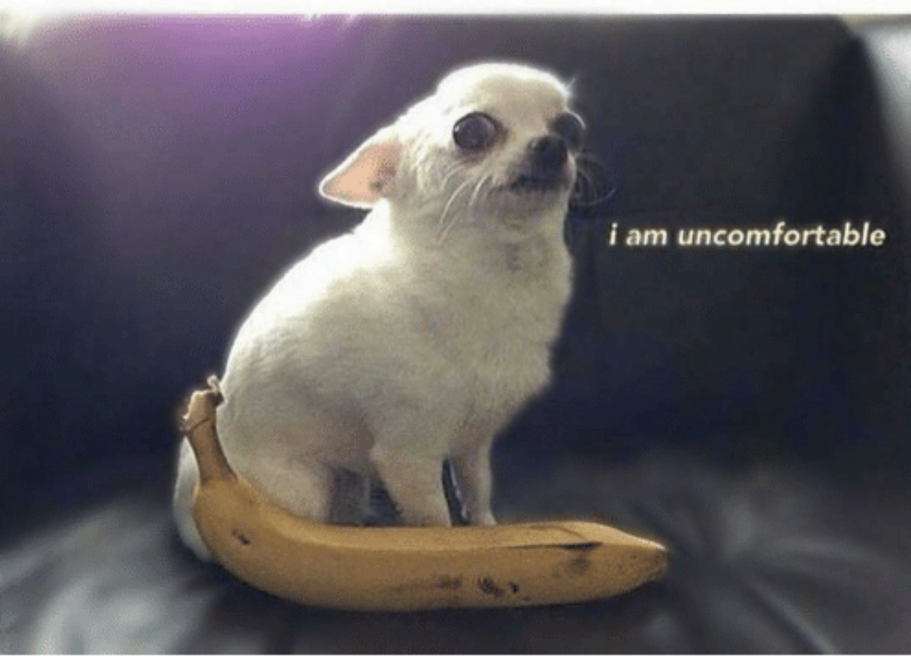
Ground rules
I may say some things that
you feel are uncomfortable
We are in a non judgement zone
You a free to speak without fear
We are not here to judge
But to learn and grow

Slide 4
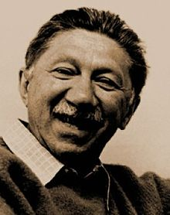
History of EI
Abraham Harold Maslow (/ˈmæzloʊ/; April 1, 1908 – June 8, 1970) was an American psychologist who was best known for creating Maslow's hierarchy of needs, a theory of psychological health predicated on fulfilling innate human needs in priority, culminating in self-actualization.^{[2]} Maslow was a psychology professor at Brandeis University, Brooklyn College, New School for Social Research, and Columbia University. He stressed the importance of focusing on the positive qualities in people, as opposed to treating them as a "bag of symptoms".^{[3]}A Review of General Psychology survey, published in 2002, ranked Maslow as the tenth most cited psychologist of the 20th century.^{[4]}

Slide 5
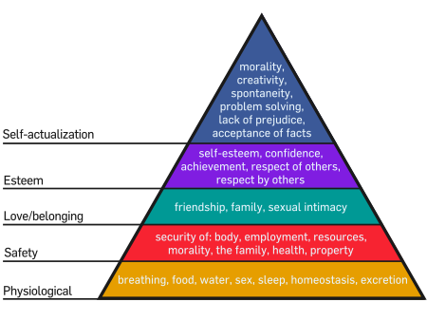
History of EI

Slide 6
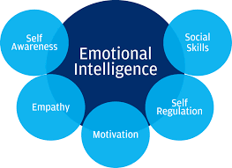
Definitions
Emotional intelligence is the capability of individuals to recognize their own emotions and those of others, discern between different feelings and label them appropriately, use emotional information to guide thinking and behavior, and manage and/or adjust emotions to adapt to environments or achieve one’s goal(s).

Slide 7
Definitions
Its different from Sympathy
Sympathy is to care and acknowledge another’s
feeling and situation.
What is Empathy?
Empathy is to actually understand, share and feel the other
persons emotions and situation.
You can put yourself in the other person’s shoes…

Slide 8
Self-Awareness
Knowledge of self
Accurate self Assessment
Self confidence
Emotional Awareness

Slide 9
Empathy
Understanding others
Service Orientation
Appreciating Diversity

Slide 10
Motivation
Achievement Drive
Commitment
Initiative
Optimism
Learning Orientation

Slide 11
Self Regulation
Emotional Self Control
Integrity
Adoptability
Innovation

Slide 12
Social Skills
Communication
Developing others
Collaboration
Cooperation
Managing Conflict
Building Influence
Building Bonds
Inspirational Leadership

Slide 13
Let’s talk about the good and the bad
What happens if our EI is too low or too high?

Slide 14
Aggressive
Demanding
Egotistical
Confrontational
Assertive
Ambitious
Driving
Strong-Willed
Decisive

Slide 15
Warm
Enthusiastic
Sociable
Charming
Persuasive
Easily Distracted
Glib
Selfish
Poor Listener
Impulsive

Slide 16
Patient
Stable
Predictable
Consistent
Good Listener
Resistant to Change
Passive
Un-Responsive
Slow
Stubborn

Slide 17
Critical
Picky
Fussy
Hard to Please
Perfectionist
Detailed
Careful
Meticulous
Systematic
Neat

Slide 18
Is not accepting to self and others
Uses Passive Aggressive Behavior
Lacks empathy
Accepts Self and Others
Can communicate assertively
Displays empathy

Slide 19
Acknowledge your own prejudices and biases!
So how do we co-exist?
Understand Empathy and how to see a situation through another’s point of view
Embrace our differences

Slide 20
What does CCR mean?
Compassion
Consideration
Respect
See those around you – understand their contributions and recognize their value
Notes:
20

Slide 21
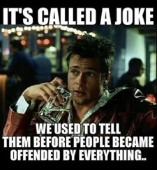
What is the opposite of CCR
The opposite of CCR is a proven environment for dysfunction.
Dysfunction in an organization stems from;
Misunderstanding
Mistreatment
Disrespect

Slide 23
The biggest step is self-assessment.
It takes courage to look in the mirror and recognize your faults.
Then take the steps to correct the bad behaviors and focus
On better ones.
Lile Michael Jackson said –
I'm starting with the man in the mirror I'm asking him to change his ways And no message could've been any clearer If you wanna make the world a better place Take a look at yourself and then make a change

Slide 24
What’s Your Takeaway?

